Slide 1
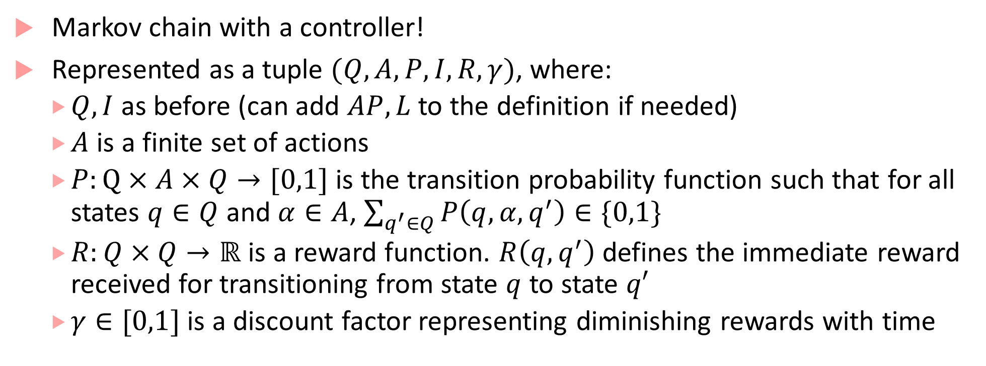
Markov Decision Process
Markov chain with a controller!
Represented as a tuple $(Q,A,P,I, R,γ)$, where:
$Q, I$ as before (can add $AP, L$ to the definition if needed)
$A$ is a finite set of actions
$P:Q×A×Q→[0,1]$ is the transition probability function such that for all states $q∈Q$ and $α∈A$, $\sum_{q^{′}∈Q}{P\left(q,α,q^{′}\right)}∈\{0,1\}$
$R:Q×Q→ℝ$ is a reward function. $R\left(q,q^{′}\right)$ defines the immediate reward received for transitioning from state $q$ to state $q′$
$γ∈[0,1]$ is a discount factor representing diminishing rewards with time

Slide 2





Autonomous Robot controlling its actions
Assume fixed target location
Reward for transitions going to target cell = 1, otherwise 0
Just part of the robot MDP showing two different actions, each action leading to next states with some probability
Which action to choose from each cell?
How do we find an optimal policy (that maximizes rewards)?
0.9
$$(i,j+1)$$
up
$$(i,j)$$
0.1
$$(i,j)$$
0.9
dn
$$(i,j−1)$$
0.1
$$(i−1,j)$$

Slide 3
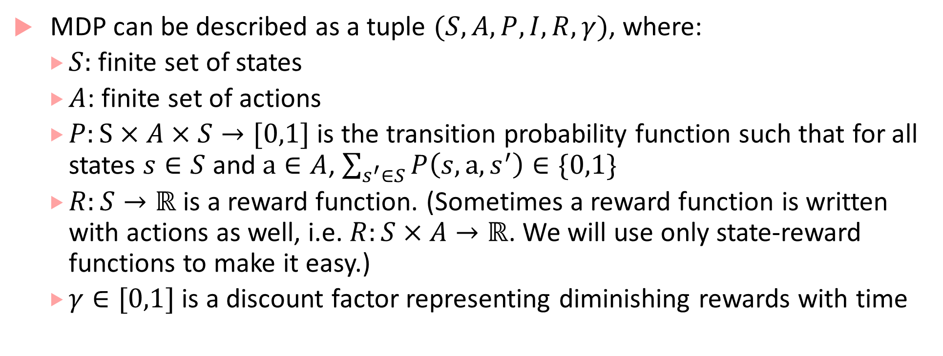
Markov Decision Process
MDP can be described as a tuple $(S,A,P,I, R,γ)$, where:
$S:$ finite set of states
$A$: finite set of actions
$P:S×A×S→[0,1]$ is the transition probability function such that for all states $s∈S$ and $a∈A$, $\sum_{s^{′}∈S}{P\left(s,a,s^{′}\right)}∈\{0,1\}$
$R:S→ℝ$ is a reward function. (Sometimes a reward function is written with actions as well, i.e. $R:S×A→ℝ$. We will use only state-reward functions to make it easy.)
$γ∈[0,1]$ is a discount factor representing diminishing rewards with time

Slide 4
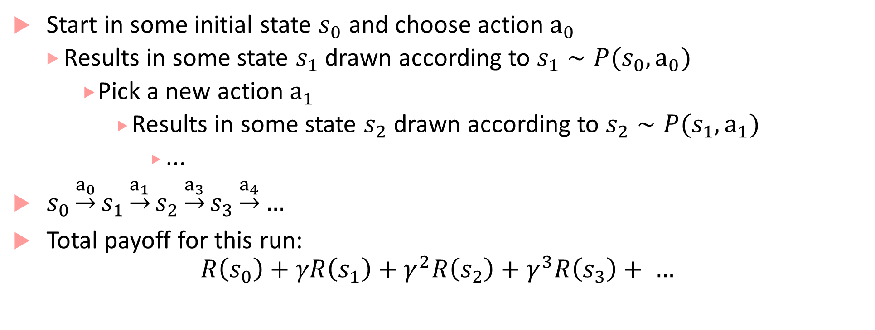
MDP run
Start in some initial state $s_{0}$ and choose action $a_{0}$
Results in some state $s_{1}$ drawn according to $s_{1}∼P(s_{0},a_{0})$
Pick a new action $a_{1}$
Results in some state $s_{2}$ drawn according to $s_{2}∼P(s_{1},a_{1})$
...
$s_{0}\underset{→}{a_{0}}s_{1}\underset{→}{a_{1}}s_{2}\underset{→}{a_{3}}s_{3}\underset{→}{a_{4}}…$
Total payoff for this run:
$$R\left(s_{0}\right)+γR\left(s_{1}\right)+γ^{2}R\left(s_{2}\right)+γ^{3}R\left(s_{3}\right)+ …$$

Slide 5
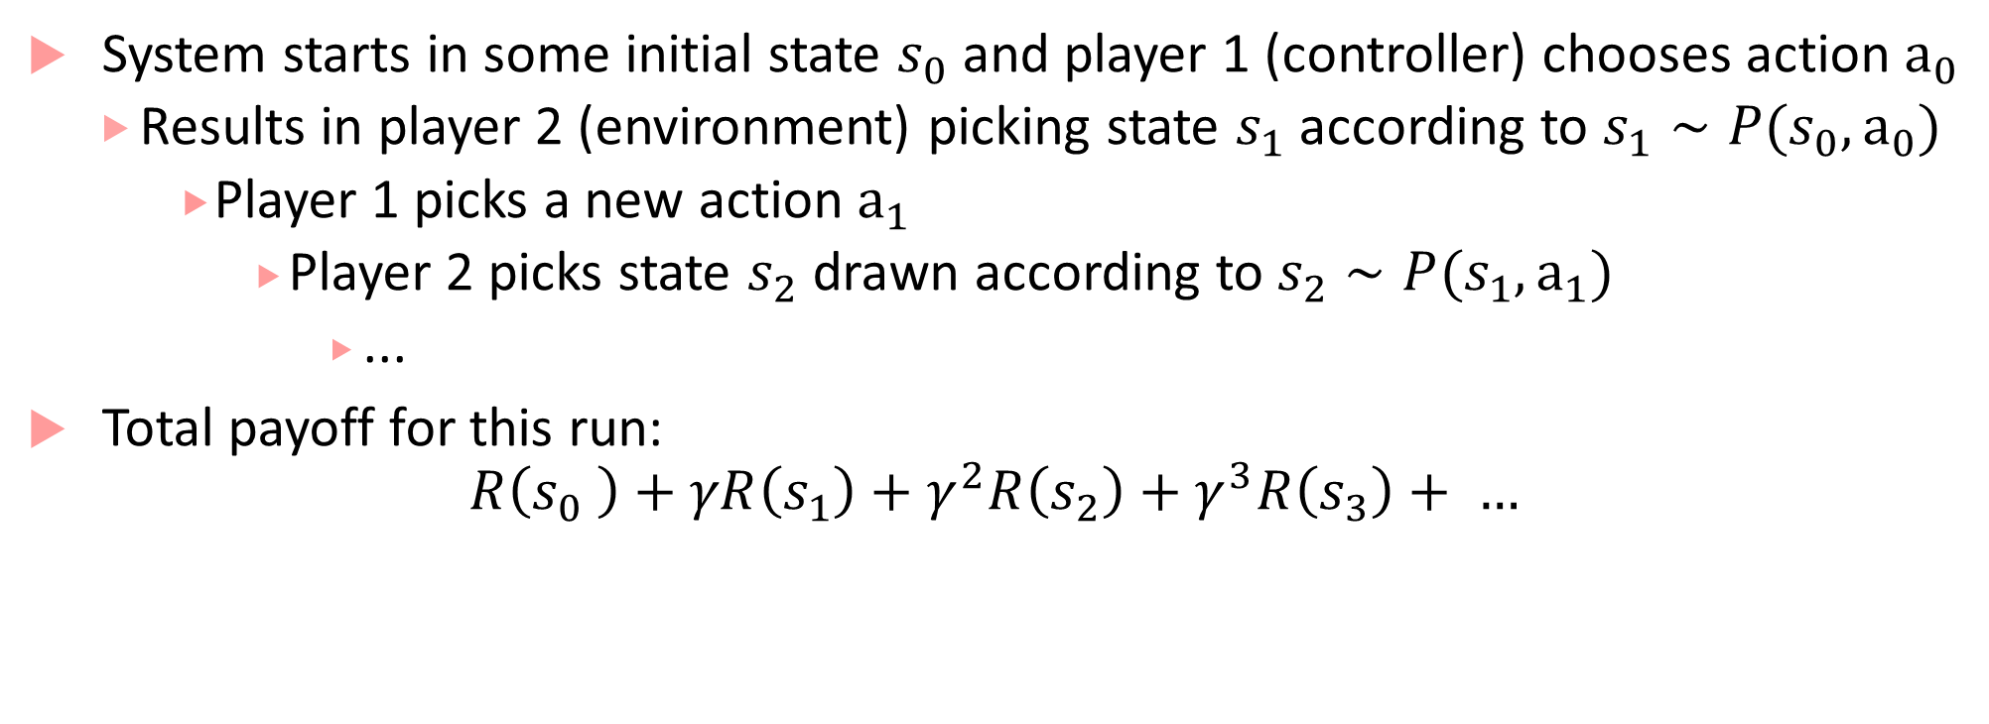
MDP as two-player game
System starts in some initial state $s_{0}$ and player 1 (controller) chooses action $a_{0}$
Results in player 2 (environment) picking state $s_{1}$ according to $s_{1}∼P(s_{0},a_{0})$
Player 1 picks a new action $a_{1}$
Player 2 picks state $s_{2}$ drawn according to $s_{2}∼P(s_{1},a_{1})$
...
Total payoff for this run:
$$R\left(s_{0} \right)+γR\left(s_{1}\right)+γ^{2}R\left(s_{2}\right)+γ^{3}R\left(s_{3}\right)+ …$$

Slide 6
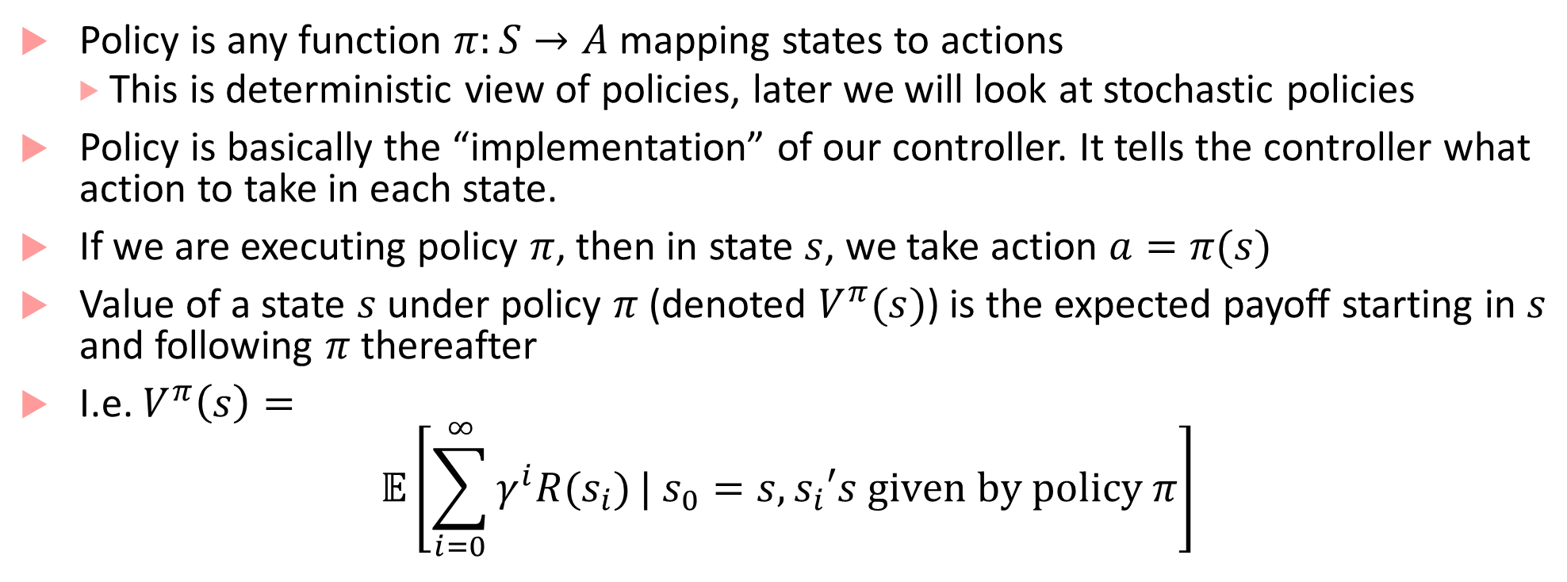
Policies and Value Functions
Policy is any function $π:S→A$ mapping states to actions
This is deterministic view of policies, later we will look at stochastic policies
Policy is basically the “implementation” of our controller. It tells the controller what action to take in each state.
If we are executing policy $π$, then in state $s$, we take action $a=π(s)$
Value of a state $s$ under policy $π$ (denoted $V^{π}(s)$) is the expected payoff starting in $s$ and following $π$ thereafter
I.e. $V^{π}\left(s\right)=$
$$𝔼\left[\sum_{i=0}^{∞}{γ^{i}R(s_{i})}| s_{0}=s, s_{i}′s given by policy π\right]$$

Slide 7
Bellman Equation
Bellman showed that :
computing optimal reward/cost over several steps of
a dynamic discrete decision problem (i.e. computing the best decision in each discrete step)
can be stated in a recursive step-by-step form
by writing the relationship between the value functions in two successive iterations.
This relationship is called Bellman equation

Slide 8
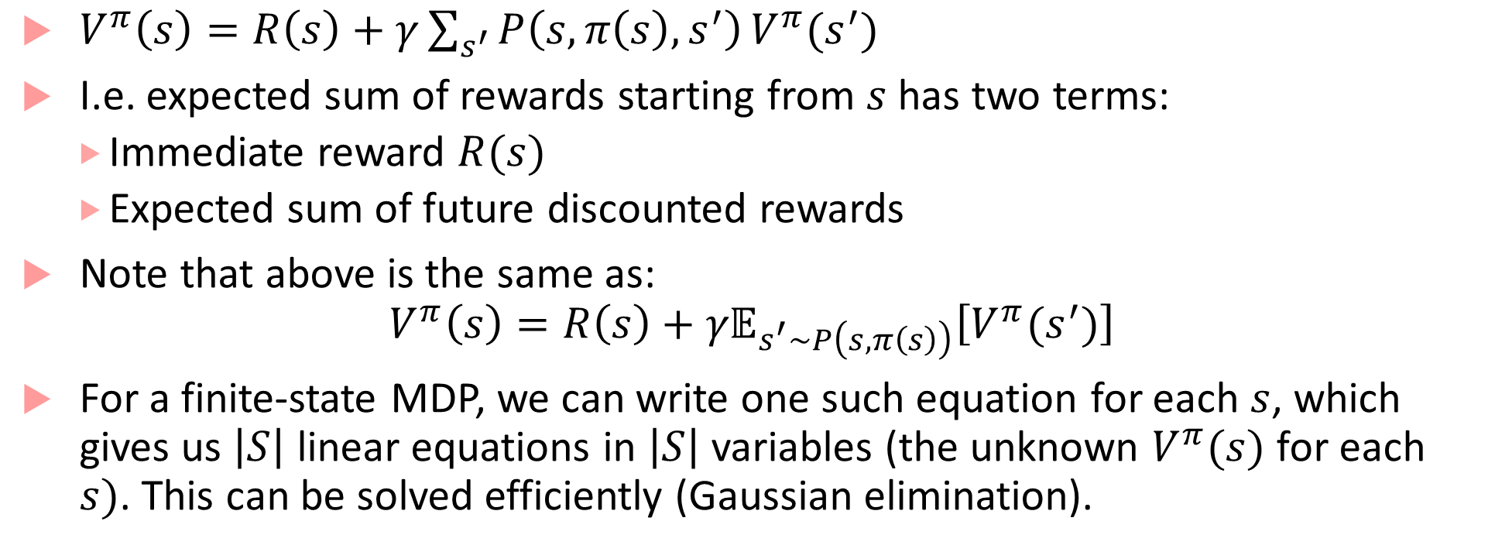
Value function satisfies Bellman equations
$V^{π}\left(s\right)=R\left(s\right)+γ\sum_{s^{′}}{P\left(s,π\left(s\right),s^{′}\right)}V^{π}(s^{′})$
I.e. expected sum of rewards starting from $s$ has two terms:
Immediate reward $R(s)$
Expected sum of future discounted rewards
Note that above is the same as:
$$V^{π}\left(s\right)=R\left(s\right)+{γ𝔼}_{s^{′}∼P\left(s,π\left(s\right)\right)}\left[V^{π}(s^{′})\right]$$
For a finite-state MDP, we can write one such equation for each $s$, which gives us $\left|S\right|$ linear equations in $\left|S\right|$ variables (the unknown $V^{π}(s)$ for each $s)$. This can be solved efficiently (Gaussian elimination).

Slide 9
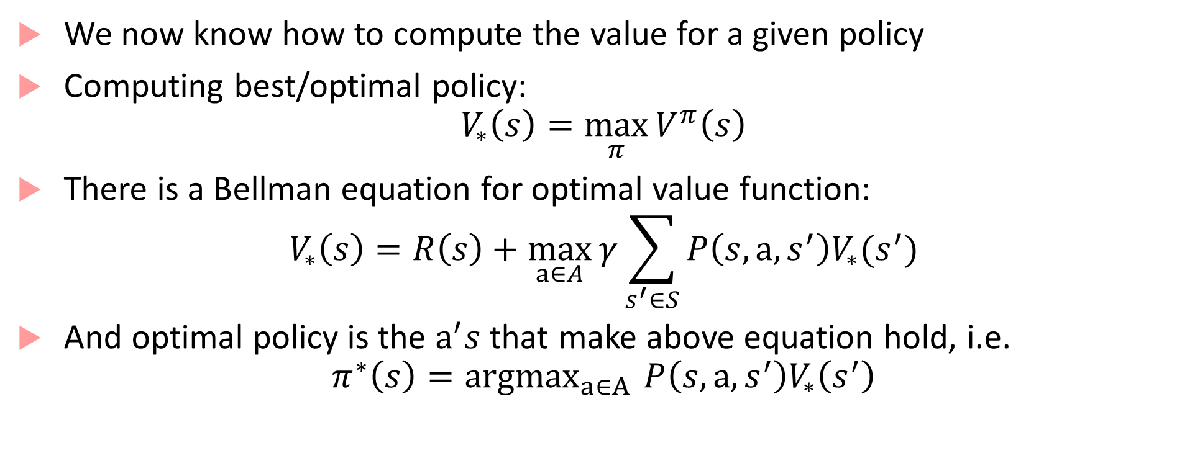
Optimal value function
We now know how to compute the value for a given policy
Computing best/optimal policy:
$$V_{∗}\left(s\right)=\max_{π}{V^{π}\left(s\right)}$$
There is a Bellman equation for optimal value function:
$$V_{∗}\left(s\right)=R\left(s\right)+\max_{a∈A}{γ\sum_{s^{′}∈S}{P\left(s,a,s^{′}\right)V_{∗}(s^{′})}}$$
And optimal policy is the $a^{′}s$ that make above equation hold, i.e.
$$π^{∗}\left(s\right)={argmax}_{a∈A }{P\left(s,a,s^{′}\right)V_{∗}\left(s^{′}\right)}$$

Slide 10
Planning in MDPs
How do we compute the optimal policy?
Two algorithms:
Value iteration
Policy iteration
Value iteration: Repeatedly update estimated value function using Bellman equation
Policy iteration: Use value function of a given policy to improve the policy

Slide 11
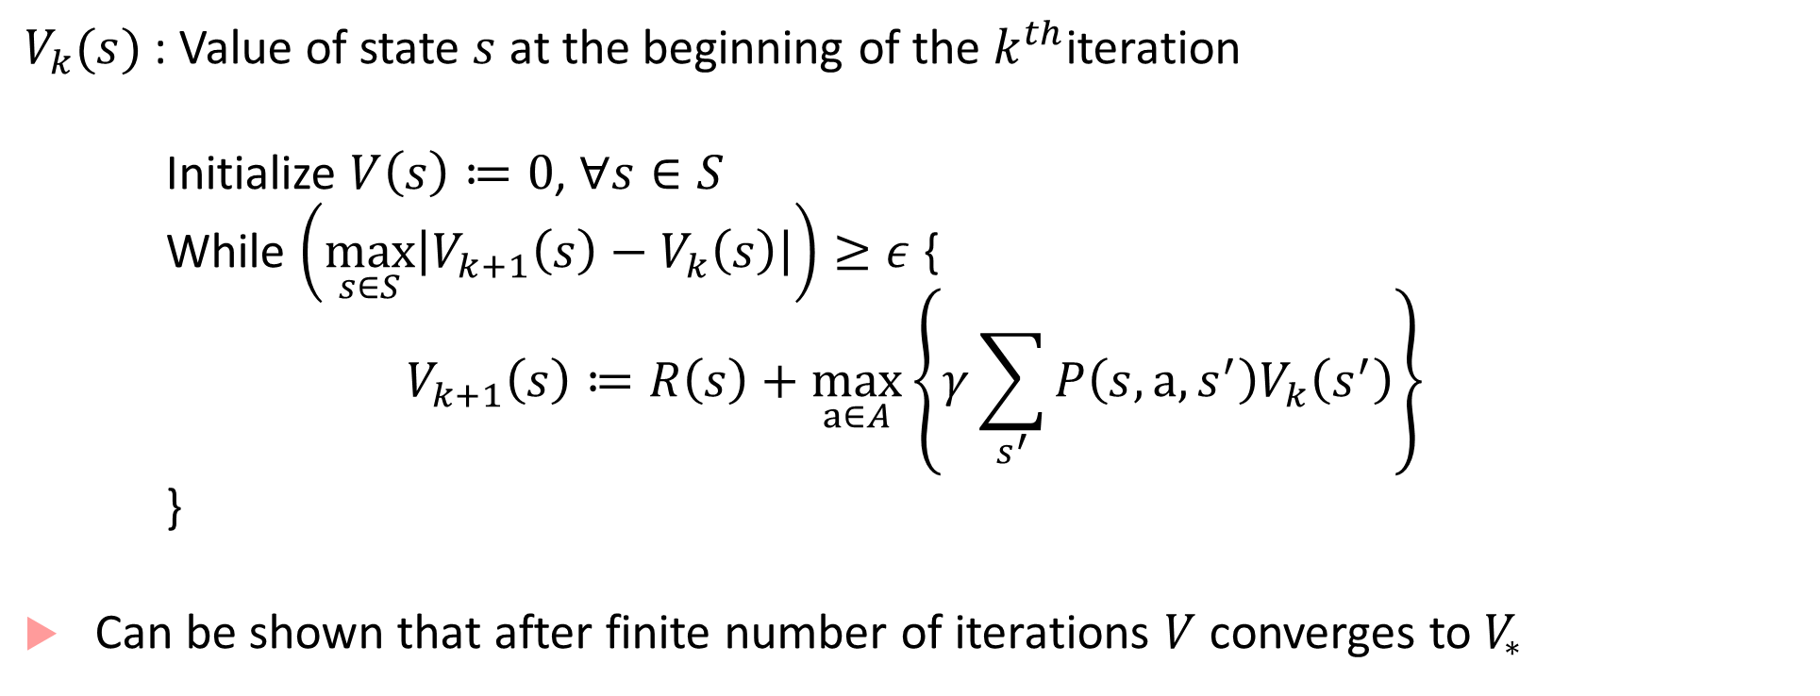
Value iteration
$V_{k}(s)$ : Value of state $s$ at the beginning of the $k^{th}$iteration
Initialize $V\left(s\right)≔0$, $∀s∈S$
While $\left(\max_{s∈S}\left|V_{k+1}\left(s\right)−V_{k}\left(s\right)\right|\right)≥ε$ {
$$V_{k+1}\left(s\right)≔R\left(s\right)+\max_{a∈A}\left\{γ\sum_{s^{′}}{P\left(s,a,s^{′}\right)V_{k}\left(s^{′}\right)}\right\}$$
}
Can be shown that after finite number of iterations $V$ converges to $V_{∗}$

Slide 12
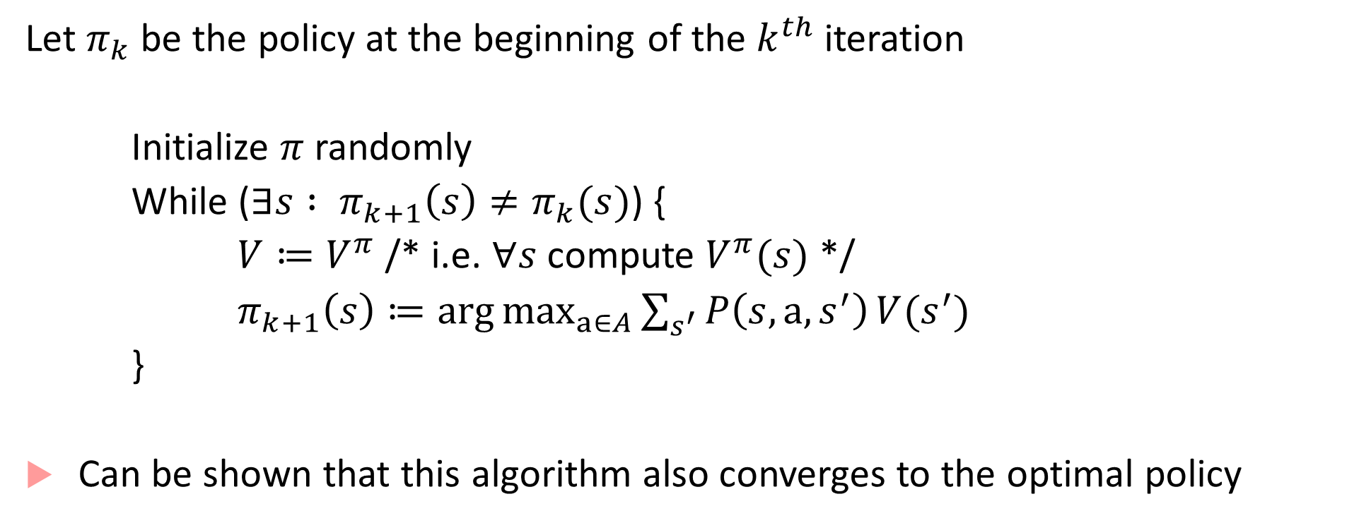
Policy iteration
Let $π_{k}$ be the policy at the beginning of the $k^{th}$ iteration
Initialize $π$ randomly
While ($∃s : π_{k+1}\left(s\right)≠π_{k}(s)$) {
$V≔V^{π}$ /* i.e. $∀s$ compute $V^{π}(s)$ */
$π_{k+1}\left(s\right)≔\arg{\max_{a∈A}{\sum_{s^{′}}{P\left(s,a,s^{′}\right)}V(s^{′})}}$
}
Can be shown that this algorithm also converges to the optimal policy
Can use the LP formulation to solve this, or an iterative algorithm

Slide 13
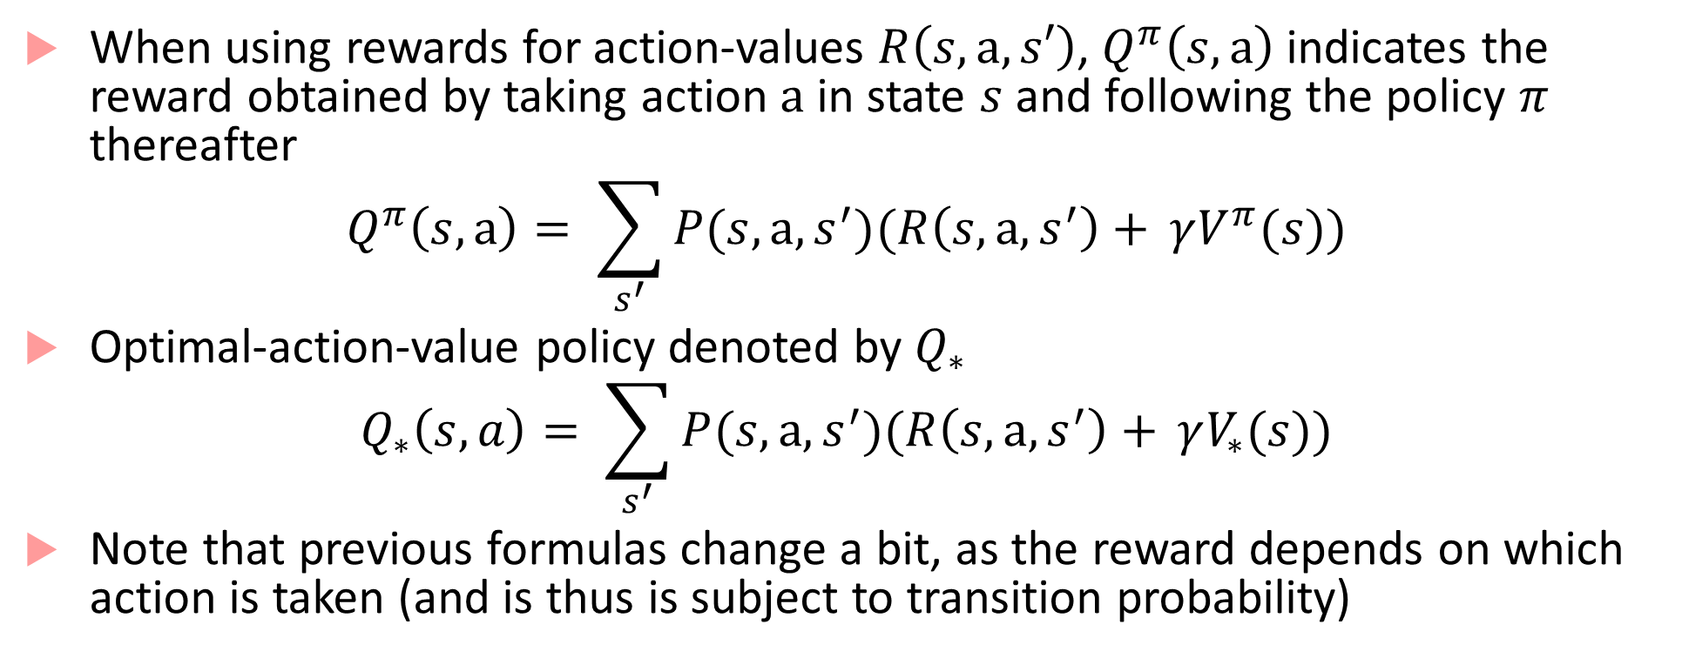
Using state-action pairs for rewards
When using rewards for action-values $R\left(s,a,s′\right)$, $Q^{π}\left(s,a\right)$ indicates the reward obtained by taking action $a$ in state $s$ and following the policy $π$ thereafter
$$Q^{π}\left(s,a\right)= \sum_{s^{′}}{P(s,a,s^{′})(R\left(s,a,s^{′}\right)+ }γV^{π}(s))$$
Optimal-action-value policy denoted by $Q_{∗}$
$$Q_{∗}\left(s,a\right)= \sum_{s^{′}}{P(s,a,s^{′})(R\left(s,a,s^{′}\right)+ }γV_{∗}(s))$$
Note that previous formulas change a bit, as the reward depends on which action is taken (and is thus is subject to transition probability)

Slide 14
Challenges
Value iteration and Policy iteration are both standard, and no agreement on which is better
In practice, value iteration is preferred over policy iteration as the latter requires solving linear equations, which scales ~cubically with the size of the state space
Real-world applications face challenges:
Curse of modeling: Where does the (probabilistic) environment model come from?
Curse of dimensionality: Even if you have a model, computing and storing expectations over large state-spaces is impractical

Slide 15
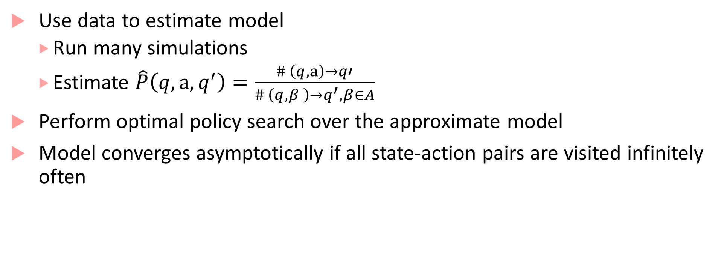
Approximate model (Indirect method)
Use data to estimate model
Run many simulations
Estimate $\hat{P}\left(q,a,q^{′}\right)=\frac{\# \left(q,a\right)→q′}{\# \left(q,β \right)→q^{′}, β∈A}$
Perform optimal policy search over the approximate model
Model converges asymptotically if all state-action pairs are visited infinitely often

Slide 16
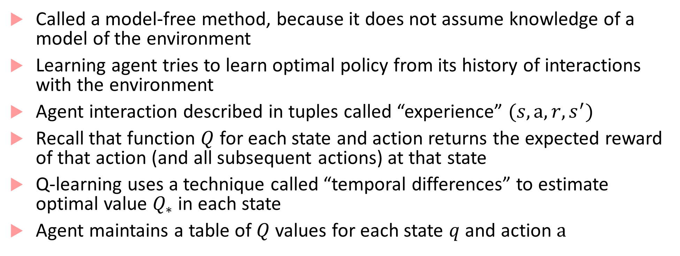
Q-learning: (Model-free method)
Called a model-free method, because it does not assume knowledge of a model of the environment
Learning agent tries to learn optimal policy from its history of interactions with the environment
Agent interaction described in tuples called “experience” $(s,a,r,s^{′})$
Recall that function $Q$ for each state and action returns the expected reward of that action (and all subsequent actions) at that state
Q-learning uses a technique called “temporal differences” to estimate optimal value $Q_{∗}$ in each state
Agent maintains a table of $Q$ values for each state $q$ and action $a$

Slide 17
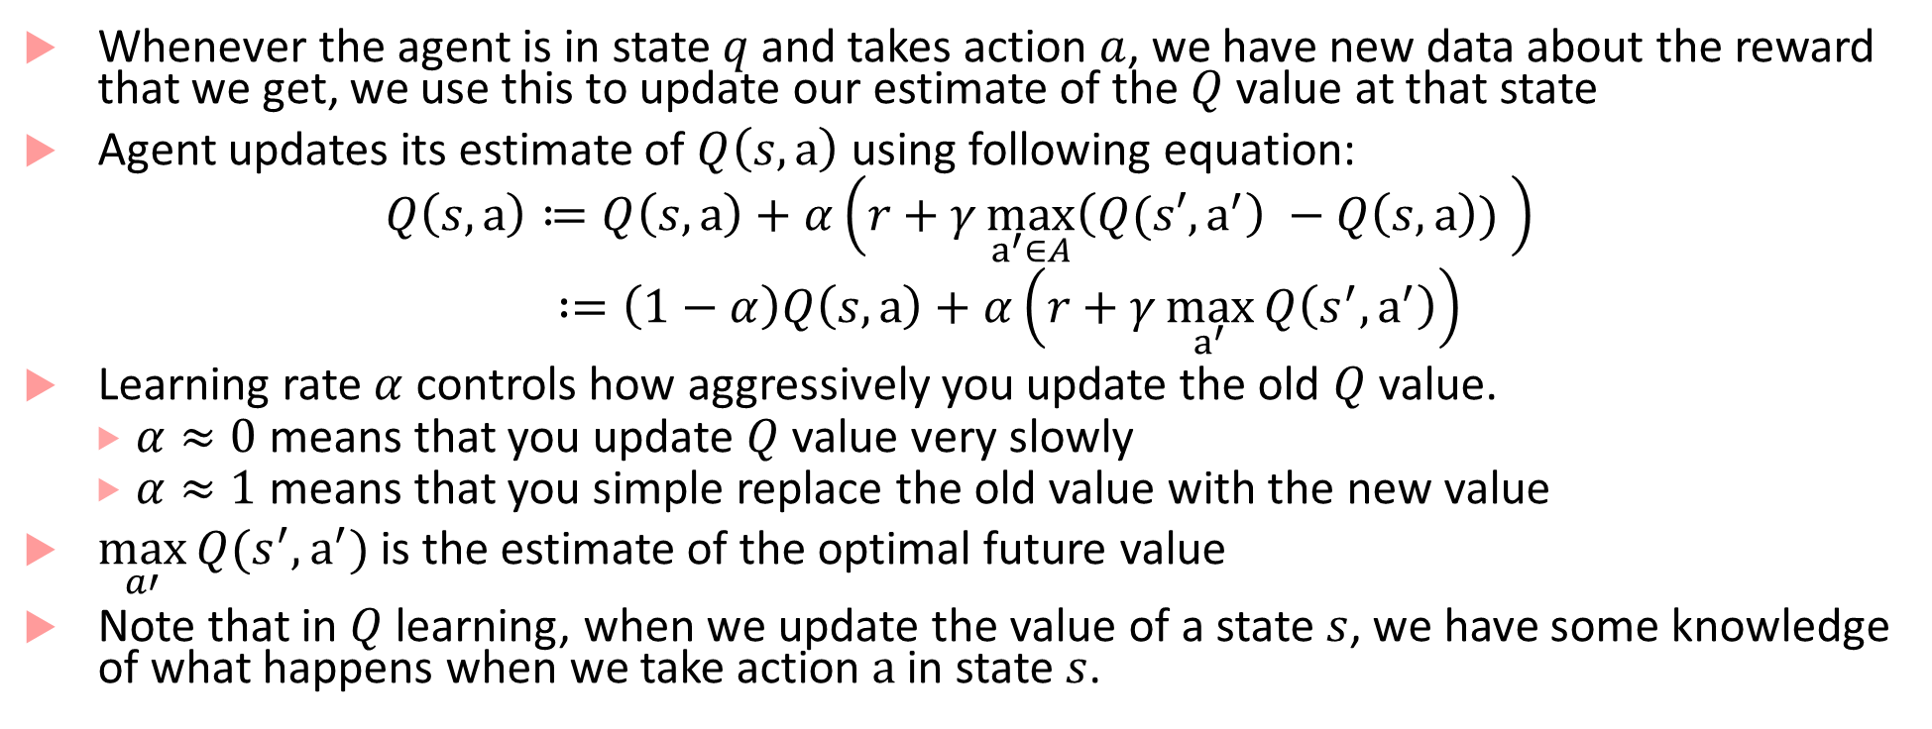
Q-learning
Whenever the agent is in state $q$ and takes action $a$, we have new data about the reward that we get, we use this to update our estimate of the $Q$ value at that state
Agent updates its estimate of $Q\left(s,a\right)$ using following equation:
$$Q\left(s,a\right)≔Q\left(s,a\right)+α\left(r+γ\max_{a^{′}∈A}\left(Q(s′,a^{′}\right) −Q\left(s,a\right)) \right)$$
$:=\left(1−α\right)Q\left(s,a\right)+α\left(r+γ\max_{a^{′}}{Q\left(s^{′},a^{′}\right)}\right)$
Learning rate $α$ controls how aggressively you update the old $Q$ value.
$α≈0$ means that you update $Q$ value very slowly
$α≈1$ means that you simple replace the old value with the new value
$\max_{a′}{Q(s^{′},a^{′})}$is the estimate of the optimal future value
Note that in $Q$ learning, when we update the value of a state $s$, we have some knowledge of what happens when we take action $a$ in state $s$.

Slide 18
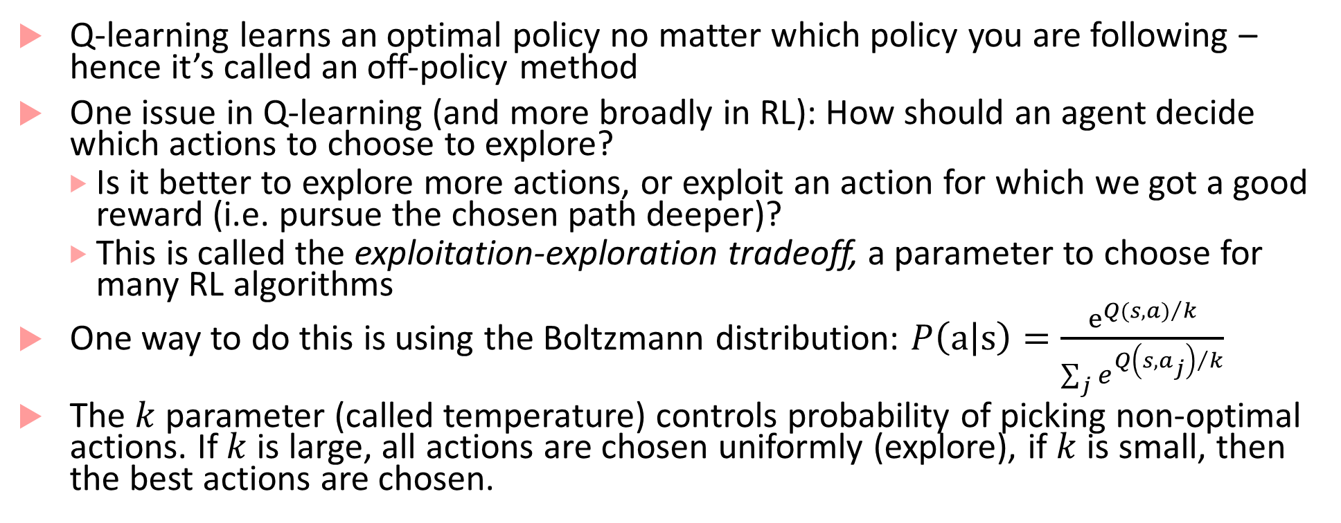
Q-learning
Q-learning learns an optimal policy no matter which policy you are following – hence it’s called an off-policy method
One issue in Q-learning (and more broadly in RL): How should an agent decide which actions to choose to explore?
Is it better to explore more actions, or exploit an action for which we got a good reward (i.e. pursue the chosen path deeper)?
This is called the exploitation-exploration tradeoff, a parameter to choose for many RL algorithms
One way to do this is using the Boltzmann distribution: $P\left(a | s\right)=\frac{e^{{Q(s,a)}/k}}{\sum_{j}{e^{{Q\left(s,a_{j}\right)}/k}}}$
The $k$parameter (called temperature) controls probability of picking non-optimal actions. If $k$is large, all actions are chosen uniformly (explore), if $k$ is small, then the best actions are chosen.

Slide 19
Some more challenges for RL in autonomous CPS
Uncertainty!
In all previous algorithms, we assume that all states are fully visible and precisely estimable
In CPS examples, there is uncertainty in states (sensor/actuation noise, state may not be observable but only estimated, etc.)
The approach is to model the underlying system as a Partially-Observable Markov Decision Process (POMDP) -- pronounced POM-DPs

Slide 20
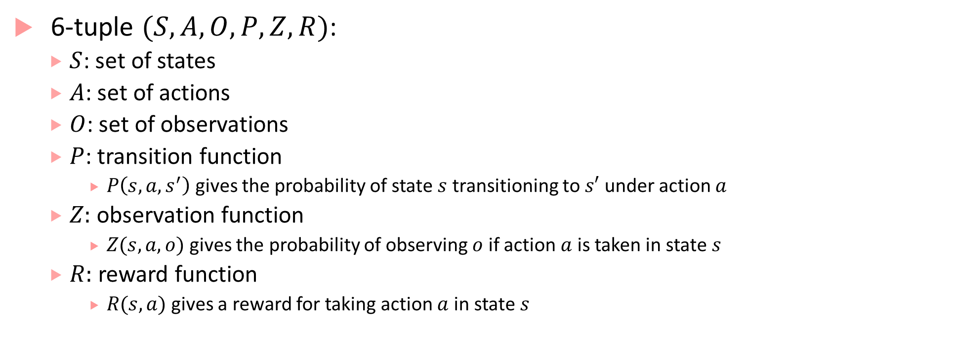
POMDPs
6-tuple $(S,A,O,P,Z,R)$:
$S$: set of states
$A$: set of actions
$O$: set of observations
$P$: transition function
$P\left(s,a,s^{′}\right)$gives the probability of state $s$ transitioning to $s′$ under action $a$
$Z:$ observation function
$Z(s,a,o)$ gives the probability of observing $o$ if action $a$ is taken in state $s$
$R:$ reward function
$R(s,a)$ gives a reward for taking action $a$ in state $s$

Slide 21
RL for POMDPs
Control theory concerns with planning problems for discrete or continuous POMDPs
Strong assumptions required to get theoretical results of optimality
Underlying state-transitions correspond to a linear dynamical system with Gaussian probability distribution
Reward function is a negative quadratic loss
Solving generic discrete POMDP is intractable, finding tractable special cases is a hot topic

Slide 22
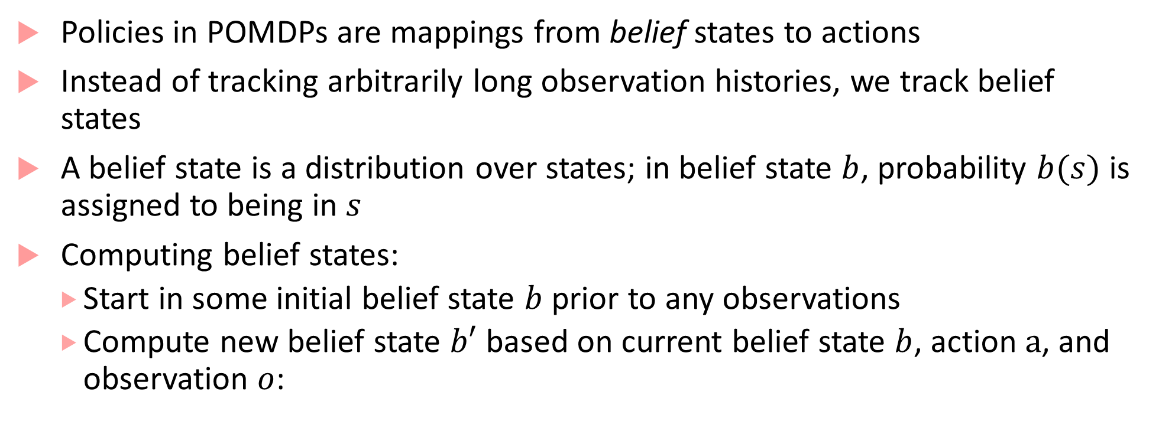
RL for POMDPs
Policies in POMDPs are mappings from belief states to actions
Instead of tracking arbitrarily long observation histories, we track belief states
A belief state is a distribution over states; in belief state $b$, probability $b(s)$ is assigned to being in $s$
Computing belief states:
Start in some initial belief state $b$ prior to any observations
Compute new belief state $b′$ based on current belief state $b$, action $a$, and observation $o$:

Slide 23
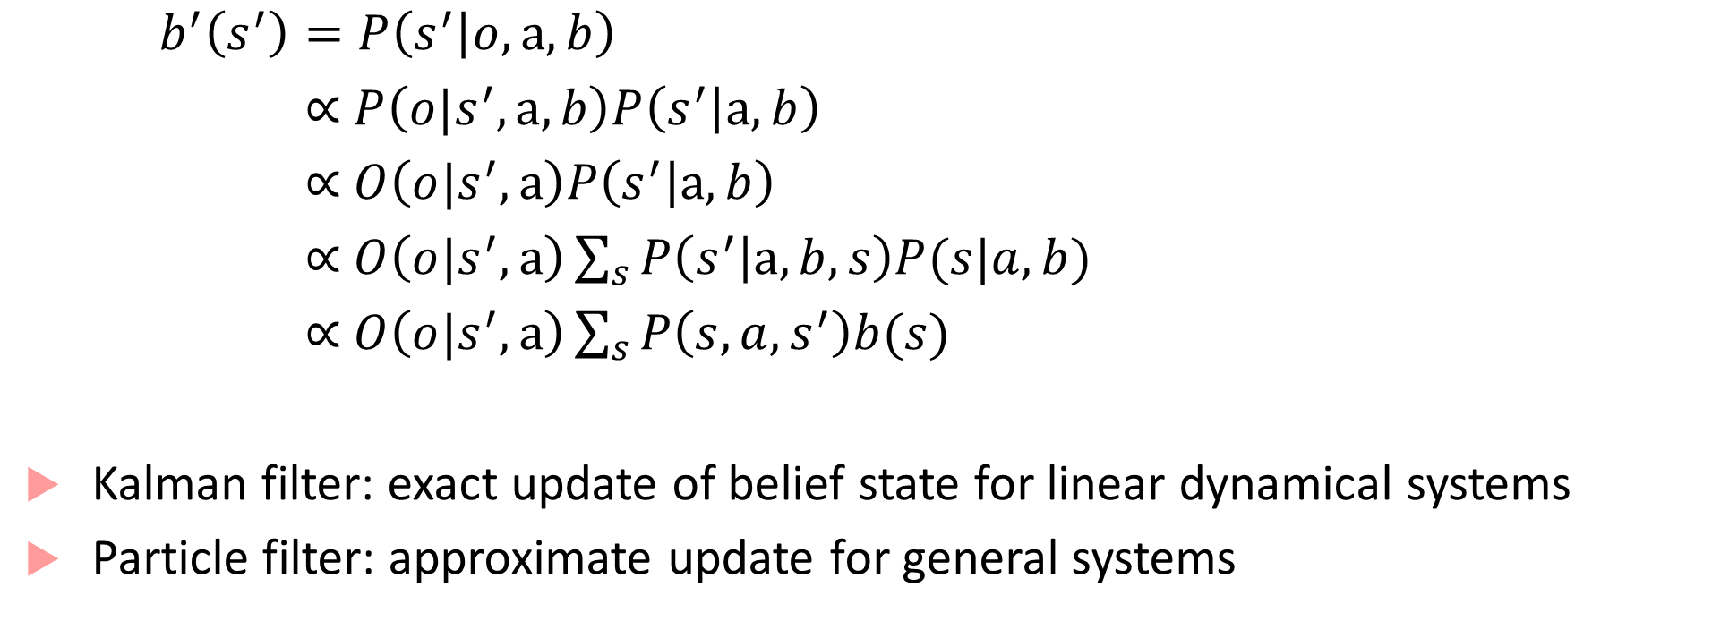
RL for POMDPS
$b^{′}\left(s^{′}\right)=P\left(s^{′} | o,a,b\right)$
$\text{∝} P\left(o|s^{′},a,b\right)P\left(s^{′} | a,b\right)$
$\text{∝} O\left(o|s^{′},a\right)P\left(s^{′} | a,b\right)$
$\text{∝ }O\left(o|s^{′},a\right)\sum_{s}{P\left(s^{′} | a,b,s\right)P(s|a,b)}$
$\text{∝ }O\left(o|s^{′},a\right)\sum_{s}{P\left(s,a,s^{′}\right)b(s)}$
Kalman filter: exact update of belief state for linear dynamical systems
Particle filter: approximate update for general systems

Slide 24
Algorithms for planning in POMDPs
Tons of literature, starting in 1960s
Point-based value iteration:
Select a small set of reachable belief points
Perform Bellman updates at those points, keeping value and gradient
Online search for POMDP solutions
Build AND/OR tree of the reachable belief states from current belief
Approaches like branch-and-bound, heuristic search, Monte Carlo Tree search

